Slide 1
Why Innovate in the Classroom?
Understanding the Need for Teaching Innovation
Anca Marcantonio

Slide 2
Changing Student Expectations
Digital-native students demand interactive and visual learning
Expect personalized and engaging experiences
Passive lectures often lead to disengagement

Slide 3
Global Shifts in Education
Blended and flipped learning are becoming the norm worldwide
China's universities are competing on a global stage
Innovation ensures relevance and competitiveness

Slide 4
Diverse Learning Needs
Students have different learning styles: visual, auditory, kinesthetic
Innovative methods cater to varied preferences and abilities
Supports inclusive and differentiated teaching

Slide 5
Technology is Transforming Education
AI tools, simulations, and analytics reshape teaching
Teachers become more efficient and responsive
Digital tools enhance both teaching and learning

Slide 6
From Memorization to Critical Thinking
21st-century skills: problem-solving, collaboration, creativity
Innovative strategies foster active and deeper learning
Prepares students for real-world challenges

Slide 7
Improved Learning Outcomes
Active learning improves performance and retention
Increases student motivation and satisfaction
Especially benefits underrepresented and struggling students

Slide 8
Managing Large & Diverse Classes
Techniques like peer instruction work well in large groups
Supports mixed-ability learners effectively
Scales without sacrificing quality

Slide 9
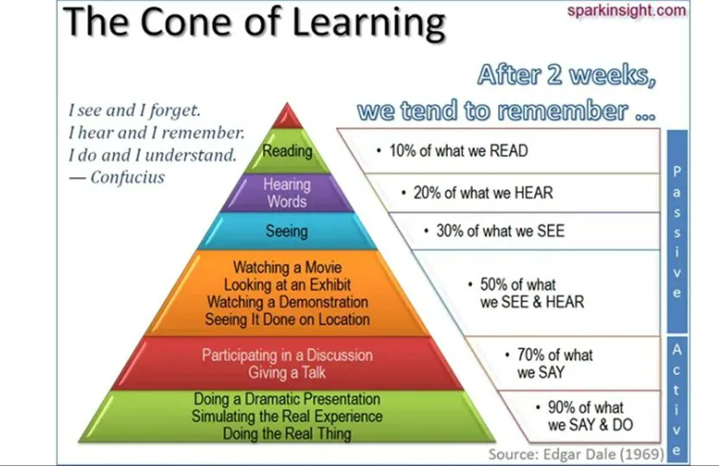
The Cone of Learning

