Slide 1

China Professional Development Conference 2024
Day 2 Delegate Activity
Sharing Teaching Resources
Aisling Kelly, China Regional Manager

Slide 2
SQA resources – setting the standard
Every year staff should look to ensure they have the latest documents to deliver our qualifications to the standard:
Course and Unit Specifications
Assessment Exemplars
Understanding Standards materials
Quality Assurance
Notes:
As an Awarding Body, SQA develops, maintains and reviews a framework of qualifications.
We define the level of knowledge and skills needed to achieve a qualification.
Our approved centres use our mandatory documentation to deliver and assess to the standard, and to measure learners' achievements against these criteria. Our quality assurance process ensures this is robust, credible and fair.
Each session, your team in centre should ensure you have the latest version of our key documents. You should check you have assessments including those needed for reassessment. Any assessments you devise in centre should be prior verified by SQA. Do this early in the session to avoid panic and delays during term time.

Slide 3
Teaching resources
SQA does not provide textbooks or mandatory reading lists. This is to promote:
Personalisation and choice for learners.
Autonomy for teaching staff.
Ability to apply learning in different contexts.
Ensuring materials are reviewed and relevant.
Notes:
We often get asked about SQA textbooks. We do not provide textbooks for any of our qualifications in any of the countries we work in. SQA sets the standard and parameters for delivery and assessment. How centres choose to meet the unit specification and assessment criteria is up to them. This approach is beneficial for several reasons:
Personalisation and choice for learners. The ability to teach and assess to suit candidates such as online, verbally or through group work.
Autonomy for teaching staff. By ensuring material is current and reflects contemporary examples; developing new case studies and assessments; variety!
Ability to apply learning in different contexts. For instance, social media and website in UK and China can vary.
Ensuring materials are reviewed each year and remain relevant.

Slide 4
Delegate Activity – Teaching resources
Peer learning.
Connect with a colleague.
Collate a bank of materials.
Notes:
We understand that having teaching resources and reading materials is useful. But the best people to share materials are your colleagues and peers. So, for today’s delegate activity we want to you write down a book, website or podcast that you have found useful.
Write your suggestion on the post-its provided and them pin on one of the flipcharts or A3 sheets on your table.
Take a note of suggestions from your colleagues. You can use your phone to take a photo of the post-its if you wish.

Slide 5
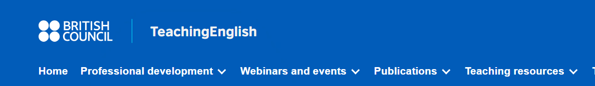
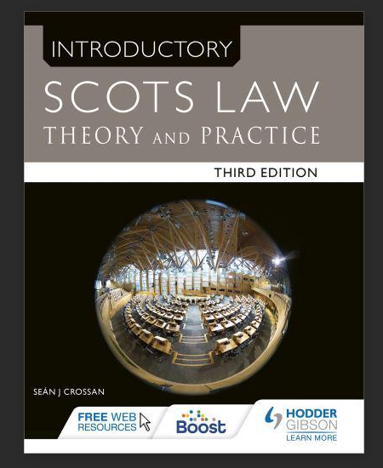
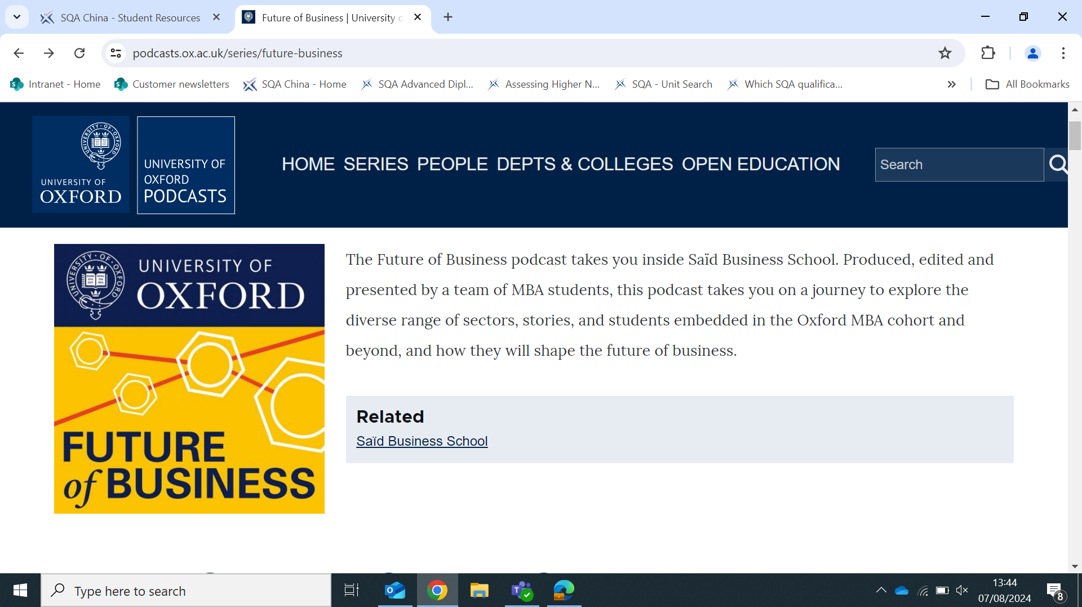
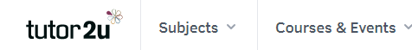
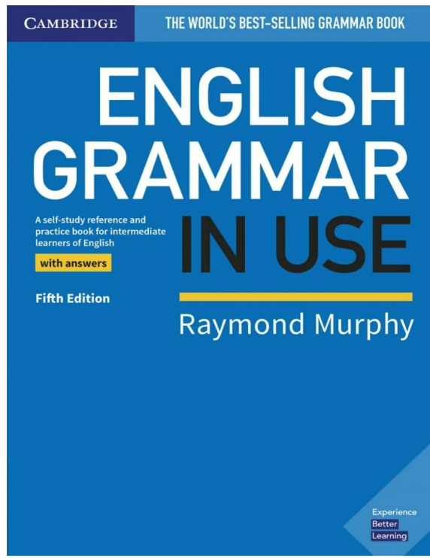
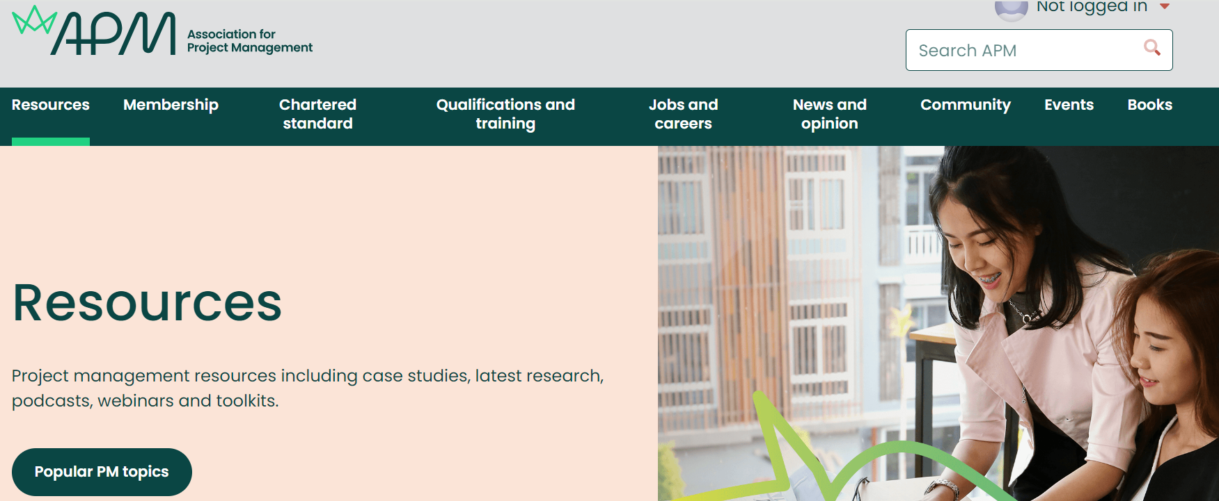
Suggestions to get you started
These are not prescriptive set texts – just some ideas to get you started!
Notes:
Before you begin, our colleagues have shared some resources they have found useful. Remember these are not prescriptive SQA set materials, just some prompts to help you begin. These include: the British Council Teaching English website. The website Tutor 2 U. The University of Oxford Future of Business Podcast. The book Introduction to Scots Law Theory and Practice. The book English Grammar in Use by Raymond Murphy. The website Association for Project Management.
Let's get started.

Slide 6
Delegate Activity – Actions
Talk to colleagues in your centre and in other centres.
Share helpful resources.
Support peer learning.
Notes:
We hope you have found this activity useful. Work within your centre, and with colleagues in other centres, to share teaching resources such as books, websites and other media.

