Slide 1

China Professional Development Conference 2024
Day 1 Workshop
Working with EV Recommendations
Iverene Bromfield, Senior External Verifier
Notes:
Day 1 Workshop

Slide 2
Purpose of this Workshop
This presentation aims to highlight:
Why EVs make recommendations
How to interpret them
What you should do with them
Where to record your responses

Slide 3
Questions
Why do you think external verifiers make recommendations?
What are the differences between recommendations and required actions?

Slide 4
Why EVs make recommendations
Which one of these statements is not true?
To suggest improvements to current practice
To share best practice
To warn you of potential non-compliance in future
To suggest new ways of working
To remind you to focus on the evidence requirements
To give you more work to do
To avoid repetition of mistakes

Slide 5
How to interpret recommendations
Recommendations fall into categories, for example:
This would be a useful improvement.
This might make my life easier.
This might be interesting to try in the future.
This should be implemented and recorded.
If I don’t implement this, there may be a problem in the future.

Slide 6
What to do with recommendations
Recommendations are not mandatory.
But do not ignore them.
Make sure you understand them. If not, ask.
Discuss them in a meeting and make a note.
Decide whether you will implement them.
If yes, include an action point in the meeting record.

Slide 7
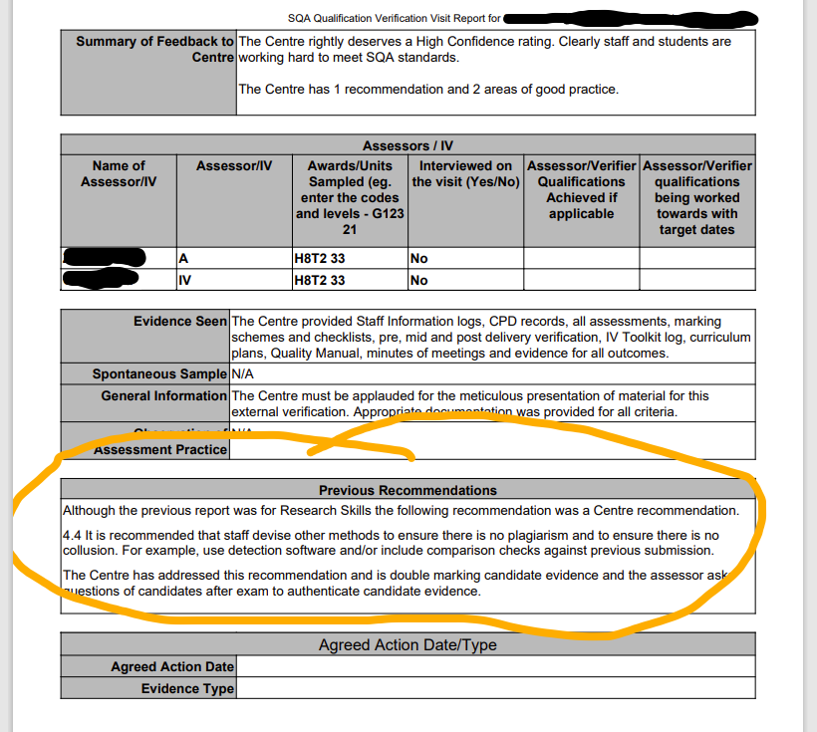
Monitoring progress

Slide 8
Where to record your consideration of recommendations
Which of these are most appropriate?
Records of team meetings
Pre-delivery internal verification checklist
Post-delivery internal verification record
Staff CPD records
Assessment Summary Report.

Slide 9
Workshop Activity
You will be given a set of recommendations.
Identify why you think each recommendation was made.
Which ones should lead to an action?
Where will you show evidence of discussion or action taken?

Slide 10
Any questions?
Notes:
Day 1 Workshop

